Slide 1

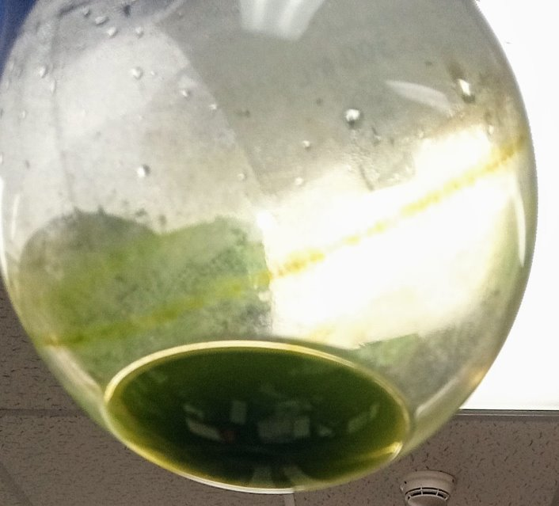
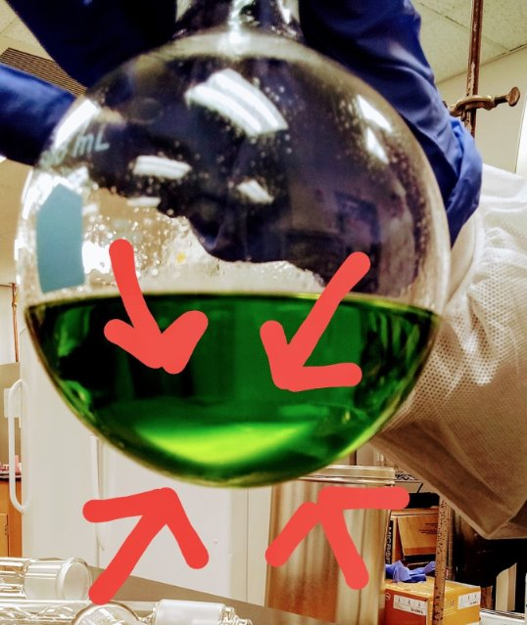
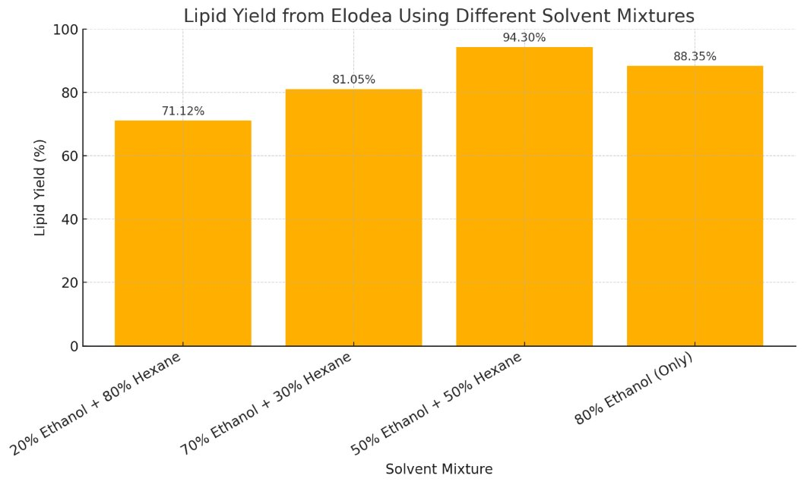
Solvent Composition and Oil Yield: Unlocking Elodea’s Potential as a Renewable Energy Source
Shankia Neko Brooks and Juan M. Morata M.S, Ed.D
Miami Dade College, Wolfson Campus, Miami, FL
Methodology
d
Conclusion
Abstract/Purpose
Discussion
This study investigates the biofuel potential of Elodea through lipid extraction using various ethanol–hexane solvent mixtures. The objective was to determine the most effective solvent composition for maximizing oil yield. Chopped Elodea biomass underwent Soxhlet extraction using four solvent systems: 20% ethanol/80% hexane, 70% ethanol/30% hexane, 50% ethanol/50% hexane, and 80% ethanol alone. Lipids were isolated post-extraction via rotary evaporation. The highest oil yield (94.3%) was achieved with the 50/50 ethanol–hexane mixture, followed by 88.35% with 80% ethanol, 81.05% with the 70/30 mixture, and 71.12% with the 20/80 mixture. These results indicate that solvent composition significantly affects extraction efficiency, with balanced ethanol–hexane ratios producing optimal yields. The findings support Elodea as a promising feedstock for biofuel production and highlight the importance of solvent optimization in enhancing lipid recovery. Further research is recommended to refine extraction protocols and evaluate scalability for sustainable energy applications.
Fresh Elodea specimens were thoroughly washed and finely chopped to prepare the biomass for lipid extraction. A Soxhlet extractor was employed to isolate lipids using four solvent systems: 20% ethanol/80% hexane, 70% ethanol/30% hexane, 50% ethanol/50% hexane, and 80% ethanol alone. Each solvent mixture was heated and continuously cycled through the biomass over multiple extraction cycles to maximize lipid recovery. Following extraction, rotary evaporation was used to separate and quantify the extracted oil. The efficiency of each solvent system was evaluated based on the total lipid yield obtained from the Elodea samples.
This study shows that a 50:50 ethanol-hexane mixture significantly improves lipid extraction from Elodea, yielding 94.3% oil compared to ethanol alone. The enhanced efficiency is likely due to hexane’s non-polar properties complementing ethanol’s polarity, allowing better lipid solubility. While ethanol is safer and more sustainable, combining it with hexane offers a practical balance for biofuel production. These results highlight the importance of optimizing solvent mixtures to improve extraction protocols. Future research should explore other ratios and plant sources to refine this approach for clean energy development.
This research highlights Elodea as a promising candidate for sustainable biofuel production. The highest oil yield—94.3%—was achieved using a 50:50 ethanol-hexane mixture, demonstrating that solvent composition plays a critical role in maximizing lipid extraction. In contrast, ethanol alone produced significantly lower yields, reinforcing the importance of using mixed solvents to enhance efficiency.
These findings are not only relevant for improving laboratory extraction protocols but also have broader implications for clean energy development. By optimizing solvent mixtures, we can increase the viability of plant-based biofuels, reduce reliance on fossil fuels, and contribute to more environmentally friendly energy solutions. Continued research in this area could accelerate the transition to greener technologies and support global efforts to combat climate change.
Results
The results demonstrated that combining ethanol and hexane was more effective for lipid extraction than using ethanol alone. The highest oil yield—94.3%—was obtained using a 50% ethanol and 50% hexane mixture. This indicates that a balanced solvent composition significantly enhances extraction efficiency. Although ethanol is a safer and more commonly used solvent, the addition of hexane improved lipid recovery from Elodea. These findings suggest that optimizing solvent mixtures is crucial for maximizing biofuel potential. Continued experimentation with solvent ratios is recommended to further improve extraction protocols and support the development of clean energy technologies.
References
Introduction
Image Credit: Shankia Neko Brooks
National Renewable Energy Laboratory (NREL). (2022). Algae Biofuels. Retrieved from https://www.nrel.gov/bioenergy/algae.html​
​
Science Buddies. (n.d.). Extracting Oil From Plants. Retrieved from​
https://www.sciencebuddies.org​
​
U.S. Department of Energy. (2023). Biofuels Basics. Retrieved from https://www.energy.gov/eere/bioenergy/biofuels-basics​
​
As global fossil fuel reserves continue to decline and their environmental impact intensifies, the search for cleaner, renewable energy sources has become increasingly urgent. Biofuels, derived from biological materials, offer a promising alternative due to their potential to reduce greenhouse gas emissions and reliance on non-renewable resources. Among various biofuel feedstocks, aquatic plants like Elodea stand out for their rapid growth, minimal land use, and ability to thrive in diverse water conditions.
Elodea, a submerged freshwater plant, contains lipids that can be converted into biofuel. However, efficient extraction of these lipids is essential to make the process viable for large-scale energy production. This study explores the effectiveness of different ethanol–hexane solvent mixtures in extracting oil from Elodea biomass. By identifying the optimal solvent composition, this research contributes to the development of sustainable biofuel technologies and supports broader efforts to transition toward environmentally responsible energy solutions.
Photo of the extracted oil after rotary evaporation​
Acknowledgements
The original research summarized herein was supported in part b U.S. Department Education grant awards P031C210035 (STEM PACTS), P031C210028 (STEM SMART), and P031A220012 (Engine of Progress); and in part by the National Science Foundation grant award 20220086 (Extending the Florida Pathways 2 Success Partnership to Increase Engagement, Retention, and Success of Low-Income Undergraduate and Graduate Students S-STEM). Any opinions, findings, conclusions, or recommendations expressed in this material are those of the authors and do not necessarily reflect the views of the funding agencies.
Image Credit: Shankia Neko Brooks
Lipid Yield by Solvent​
Photo of the extracted oil within solvent after soxhlet process​

